Slide 1
DataOrbit:
Healthcare Provider
Fraud Detection
A proactive machine learning solution to flag high-risk providers.

Slide 2


Executive Summary
The Challenge
Our Objective
Healthcare fraud imposes a massive financial burden ($68B+ annually). Reactive systems fail to catch complex schemes in real-time.
Develop a proactive ML solution to flag high-risk providers while strictly minimizing false positives to save auditor time.

Slide 3
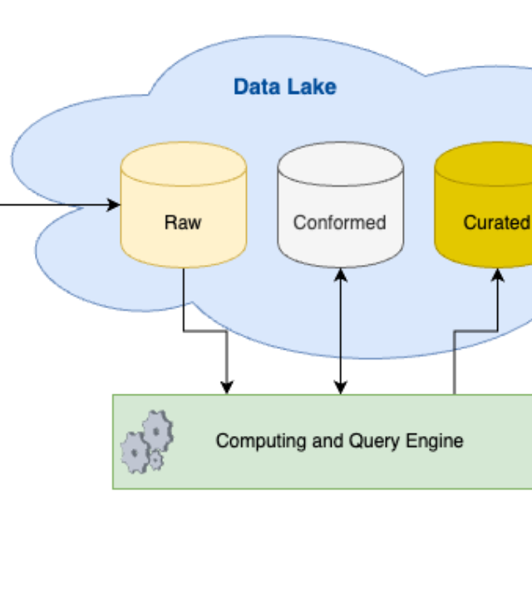
Data Architecture
CMS Source Data
•
Labels: Fraud status
•
Beneficiary: Demographics
•
Inpatient: Admissions
•
Outpatient: Visits

Slide 4



Feature Engineering
Volume Metrics
Financial Metrics
Network Metrics
Claim counts & beneficiary counts per provider.
Total reimbursement amounts & deductibles.
Patient churning ratios & inpatient admission rates.

Slide 5
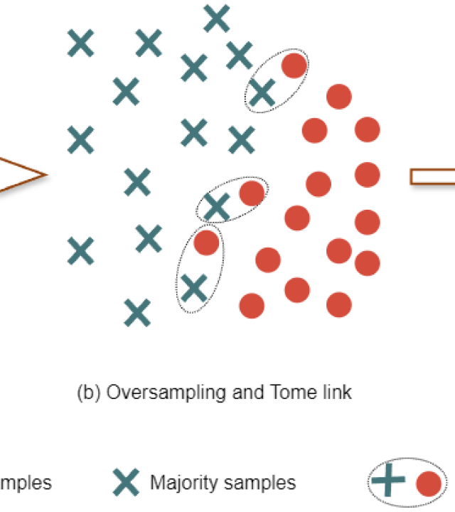
Methodology: SMOTE
The 9.3% Problem
Only 9.3% of providers were fraudulent. Standard models bias heavily towards the majority class (non-fraud).
The Solution
We applied Synthetic Minority Over-sampling Technique (SMOTE) to the training data to help the model learn fraud patterns effectively.

Slide 6


Modeling Strategy
Baseline: Logistic Regression
Primary: Random Forest
Pros: High interpretability.
Pros: Non-linear ensemble learning.
Cons: Linear assumption. High Recall but low Precision (too many false alarms).
Why: Captures complex interactions between volume and demographics better than linear models.

Slide 7
Model Evaluation Matrix
Metric | Logistic Regression | Random Forest | Interpretation
ROC-AUC | 0.92 | 0.92 | Both rank risk effectively.
Precision | 0.40 | 0.51 | RF is significantly better at reducing false alarms.
Recall | 0.85 | 0.71 | LR catches more but flags many innocents.
F1-Score | 0.54 | 0.60 | RF is the balanced choice.

Slide 8
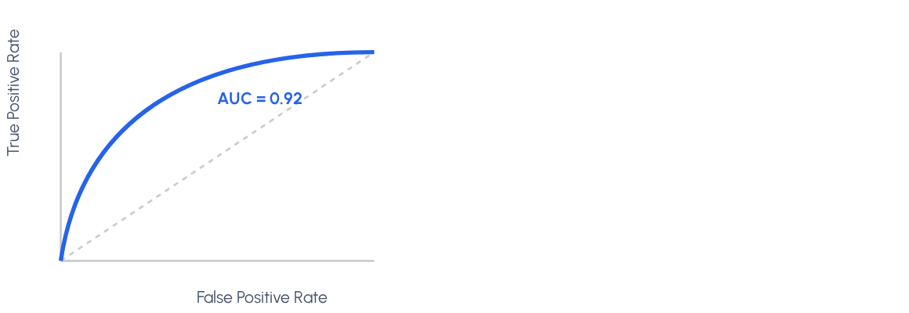
ROC Curve – Random Forest
Strong Separation
The Random Forest model achieves a strong ROC-AUC of 0.92.
This indicates a high ability to distinguish between fraud and legitimate providers across various threshold settings.

Slide 9
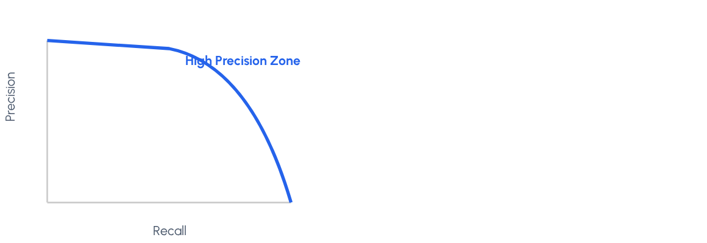
Precision-Recall Curve
Why PR Matters
Due to the class imbalance (only 9.3% fraud), accuracy is misleading. The PR Curve shows us the trade-off between capturing fraud (Recall) and being right when we do (Precision).
RF maintains high precision even at decent recall levels.

Slide 10



Confusion Matrix (Test Set)
Predicted: No
Key Takeaways
Predicted: Yes
Actual: No
•
TP (450): Successfully caught 450 fraud cases.
•
FP (200): Only 200 legitimate providers were inconvenienced.
8,500
200
True Negatives
False Positives
•
FN (150): Missed some fraud, but minimized noise significantly compared to LR.
Actual: Yes
150
False Negatives
450
True Positives

Slide 11
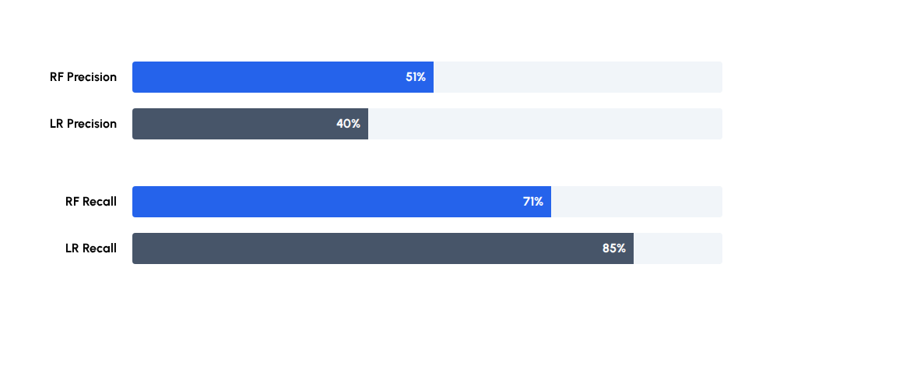
Precision vs. Recall Trade-off
Random Forest (Blue) sacrifices some recall to gain significant precision.

Slide 12
Why Random Forest Is the Final Model
Decision Drivers
Feature | Random Forest | Gradient Boosting
Interpretability | High (Feature Imp.) | Low (Black Box)
Stability | High | Sensitive to noise
Overfitting | Low Risk | High Risk
•
Transparency: We can explain why a provider was flagged.
•
Stability: It performs consistently even when retraining on new data.
•
Efficiency: Faster training and deployment cycles than boosting methods.

Slide 13

Operational
Conclusion
Random Forest is the clear recommendation. Its superior precision ensures the audit team focuses on high-probability targets, saving millions in operational costs.

Slide 14
Questions?
DataOrbit Project Review

Slide 15


Image Sources
https://miro.medium.com/v2/resize:fit:666/1*vh1hFhWU0w0CzCiA64Xy3A.png
Source: medium.com
https://pub.mdpi-res.com/mathematics/mathematics-12-01709/article_deploy/html/images/mathematics-12-01709-g001.png?1718092992
Source: www.mdpi.com

